Slide 1
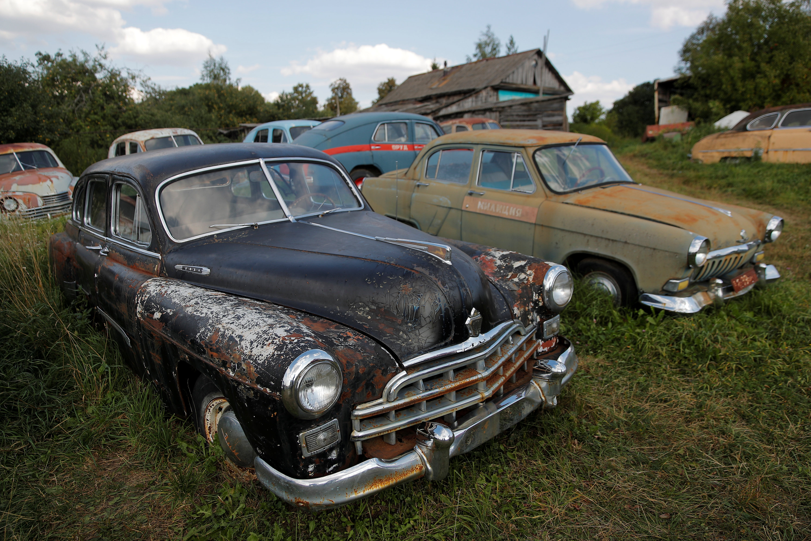
PREDICTION OF OLD CAR PRICE
BY:
PRASHANT KUMAR VISWAKARMA
This Photo by Unknown Author is licensed under CC BY-NC

Slide 2

Problems :-
Peoples don’t have idea about the exact price of the used cars to buy or sell?

Slide 3

I have developed a model based on previous data using cars24.com and predict the price of used car.

Slide 4

Let’s start the journey

Slide 5

About :- The Data Set
Dataset :- The data is scrapped from cars24.com in the month of march-2021 using selenium.
Features:
Independent variables :
Name: Car Model name along with purchase year of the car.
Rating: Rating given while car inspection by cars 24 team.
City: City of that car placed for advertisement ,city is given in terms of code format.
Kilometers : How many kilometers that particular car has driven for before placing that advertisement .
Year of purchase : Original Date of purchase of that car.
Owner: How many previous owners it had before selling on cars24 site.
Fuel type: Type of fuel which car runs on.(Petrol, diesel …)
Transmission: whether car is automated or manual transmission.
RT0: Car registered under which RTO .
Insurance: expiry date of the insurance if any.
Insurance Type : Different types insurance availed by owner.
Target : Predict the price of the used car.

Slide 6
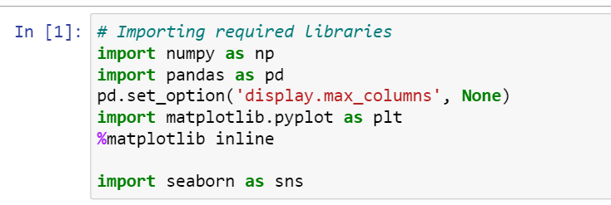
Import required libraries to use on the collected dataset

Slide 7
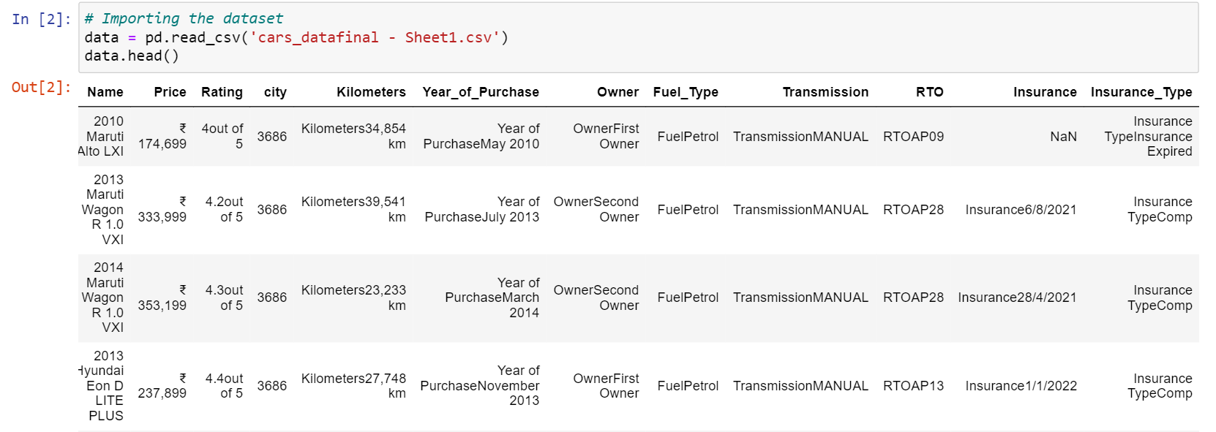
These Columns were present in the dataset.

Slide 8

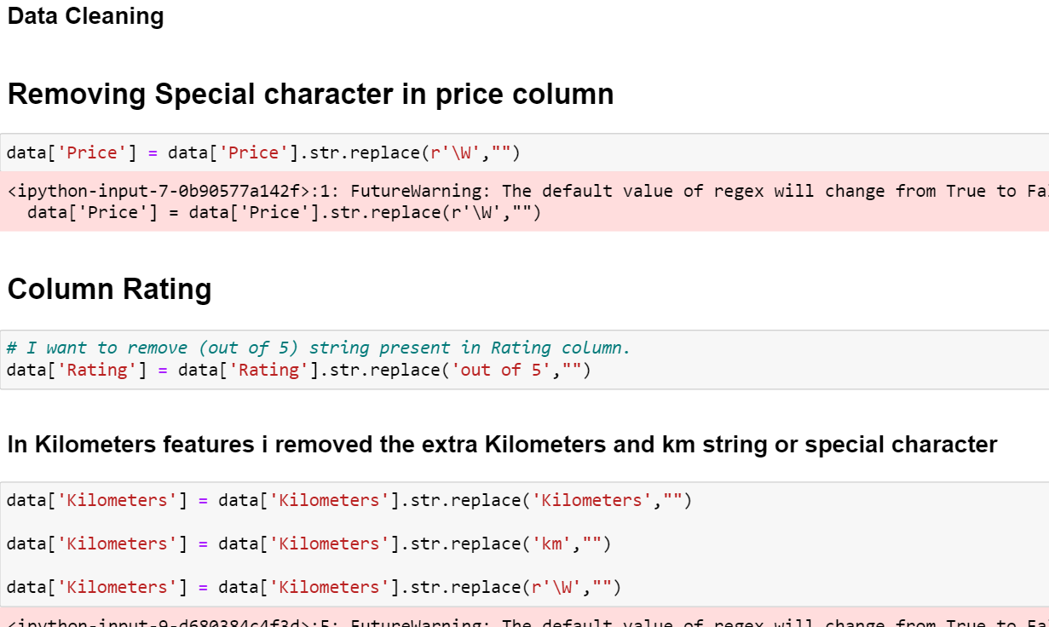
Step 1 : Data cleaning
Remove the Special characters, Unwanted Numbers and Duplicate strings.

Slide 9
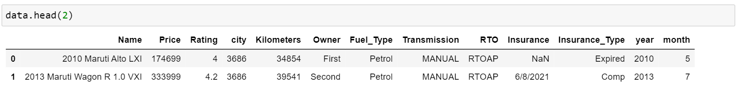
After removing contaminent data Dataset is shows:-

Slide 10
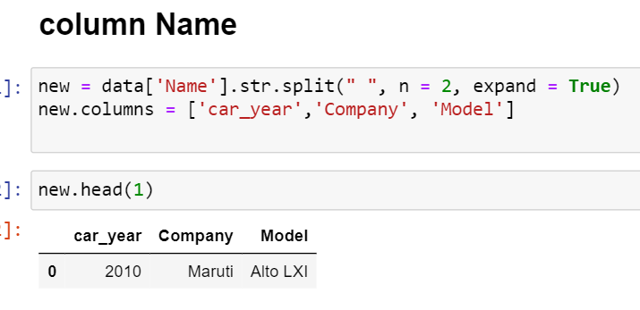
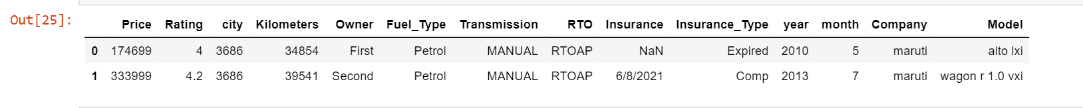
Some columns contain multiple information, we need to capture it in separate features.

Slide 11

Step :- 2
EDA :- Exploratory Data Analysis

Slide 12
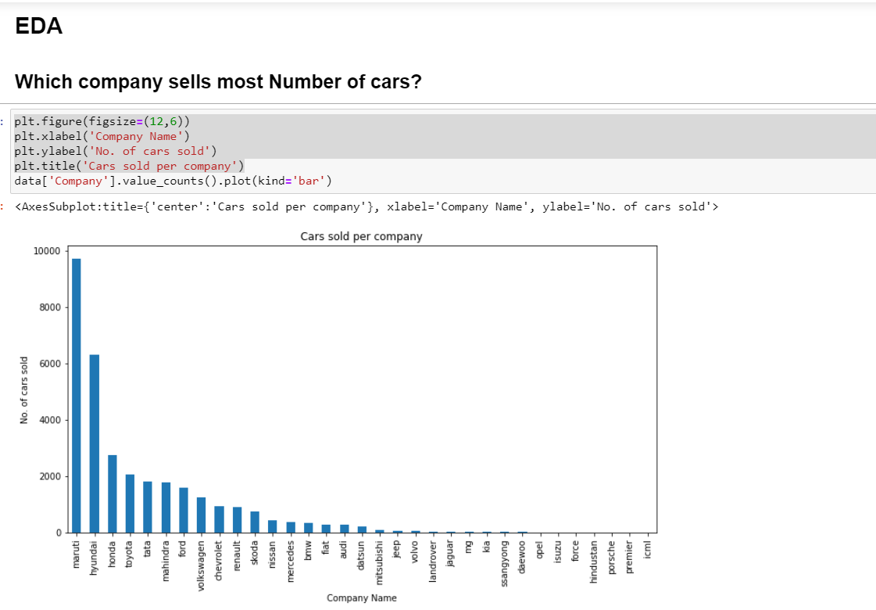

Slide 13
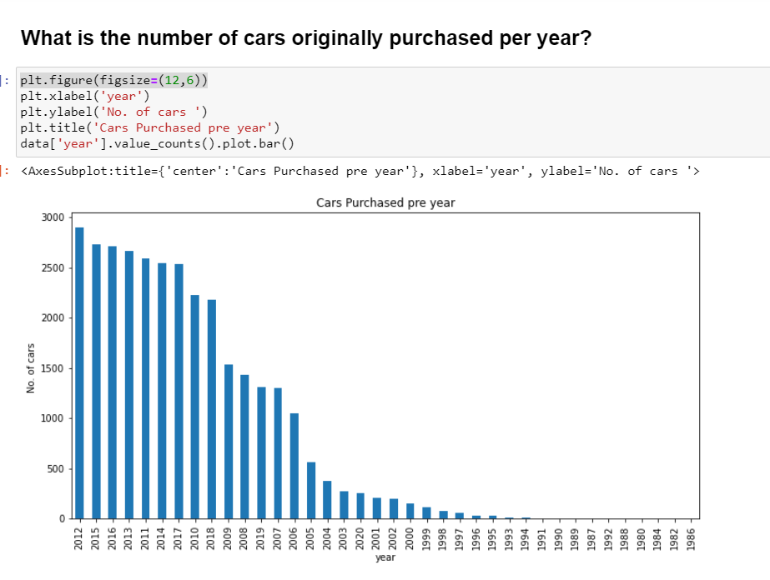

Slide 14
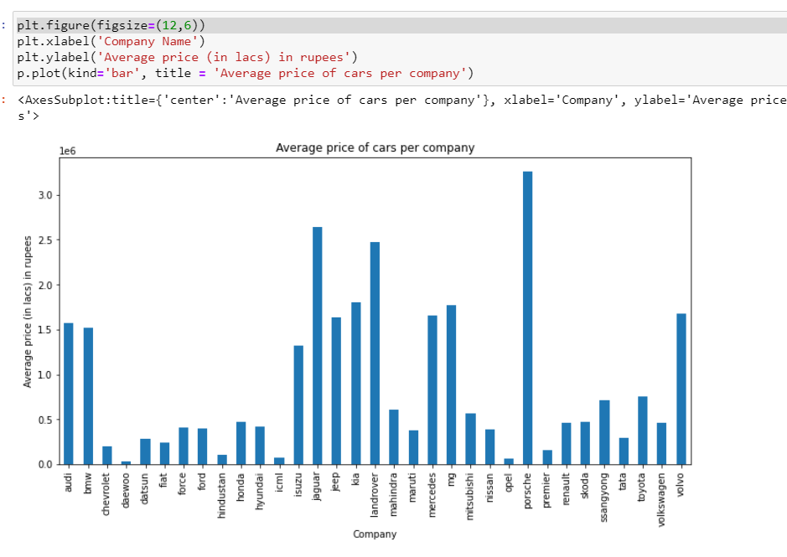
What is the average price per company?

Slide 15
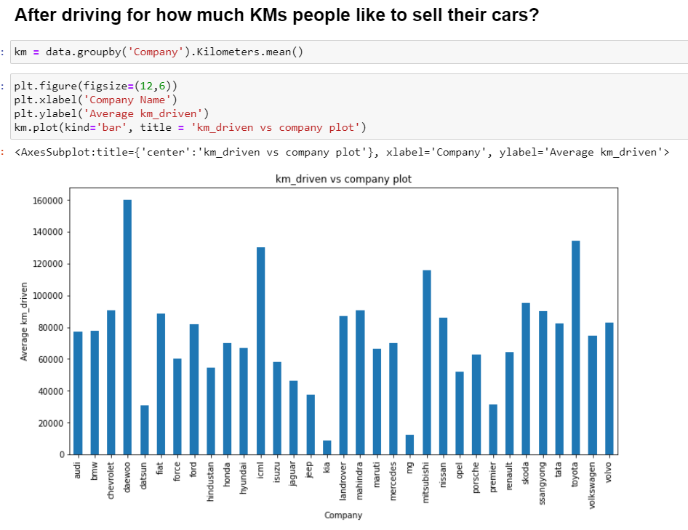

Slide 16

Step 3 :- Data Pre-processing

Slide 17
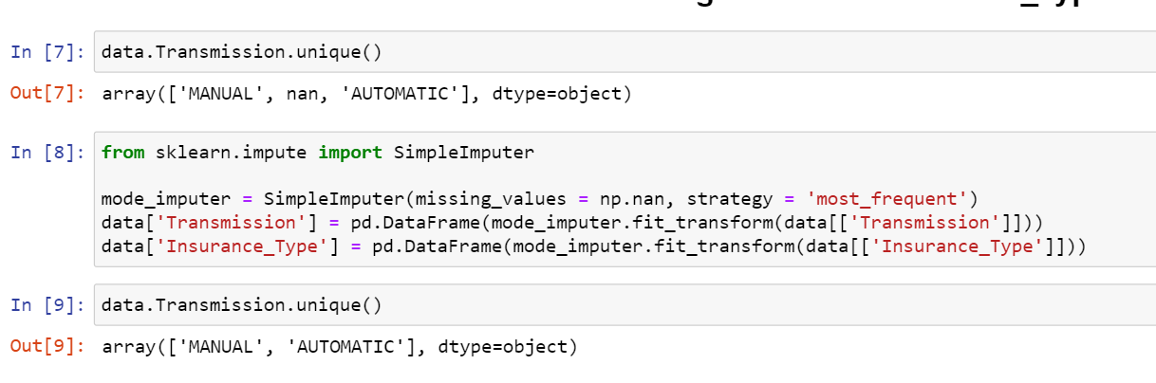
Checking the Null values and Fill with suitable technique

Slide 18
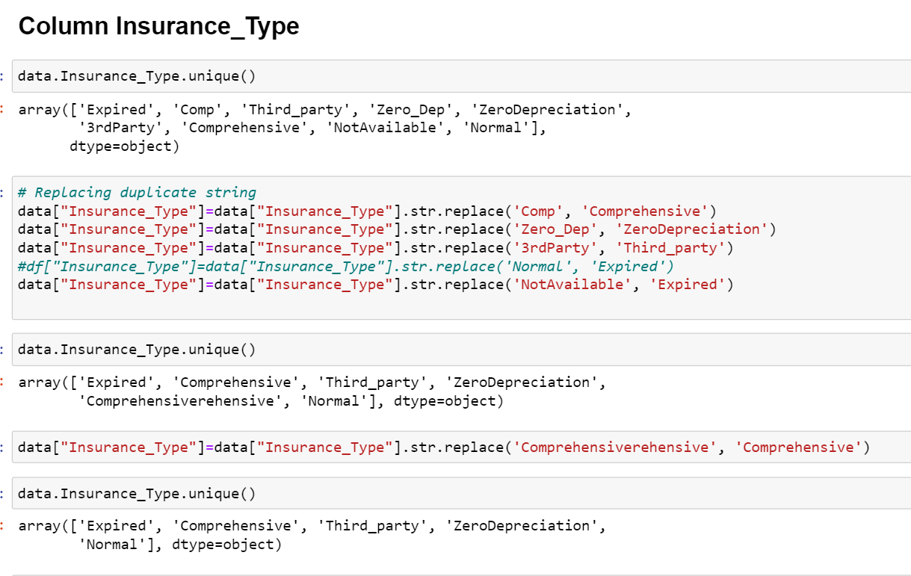
Took to same category

Slide 19
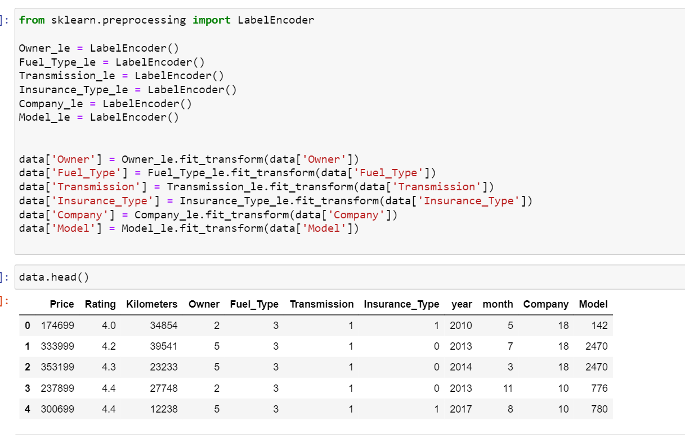
Converting categorical variables into Numeric with best Encoding Technique

Slide 20
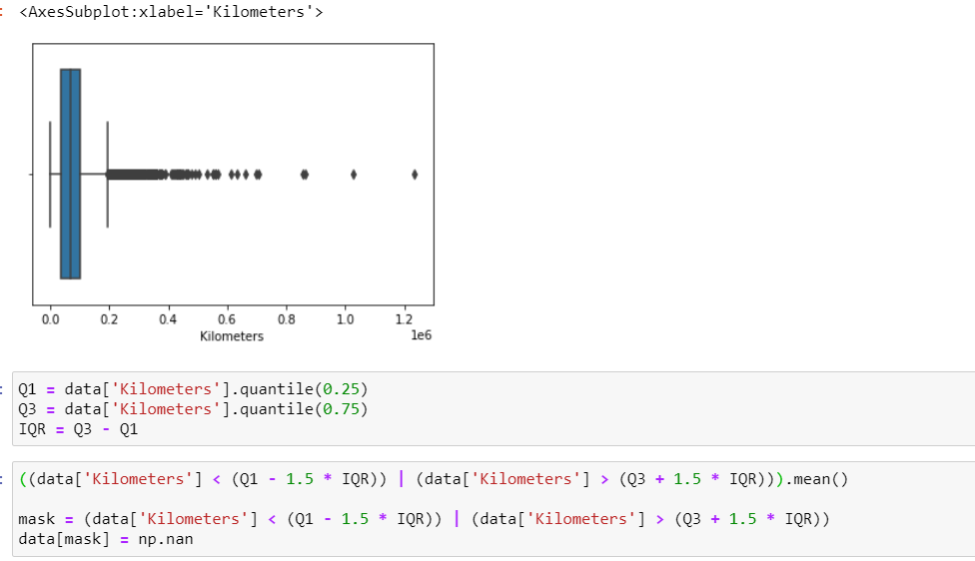
Outliers Treatment :- If the data points not in the range of 1 to 100 percentile then we can considered it as a outliers.

Slide 21
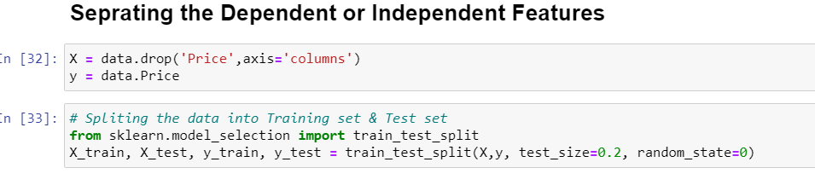
Step 3 : Separate the attributes into dependent and independent features. Spilt the data into train and test. Train is used for fit the model and test is used for checking of correctness of model.

Slide 22

Modeling

Slide 23
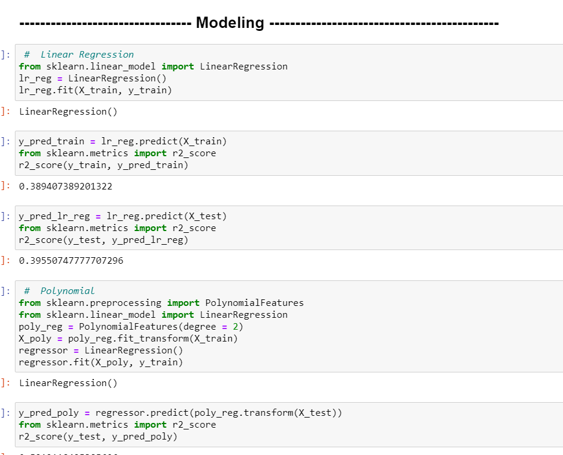
Applied various models to check which model gives good result:-

Slide 24
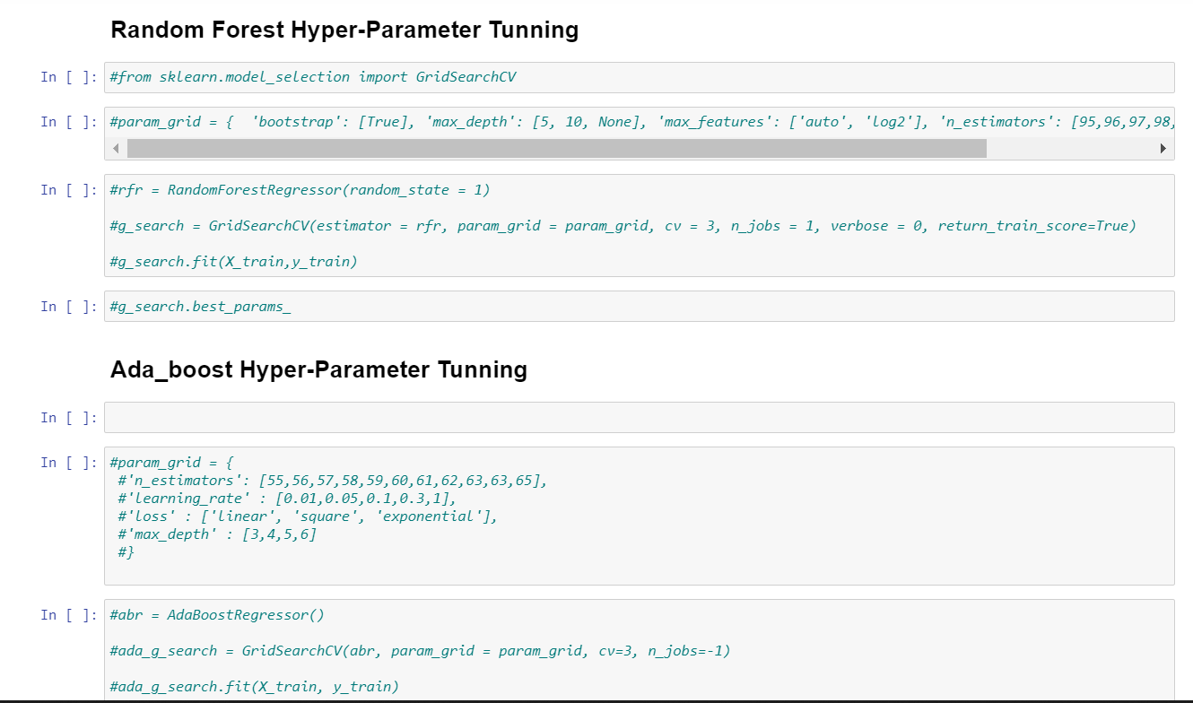
Step 5 :- Model Boosting
Changing Hyper parameters using grid search cv.

Slide 25
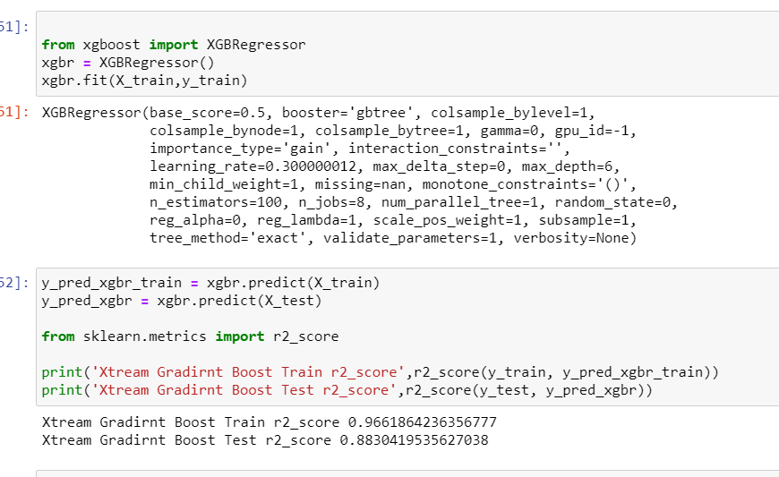
Final model with best accuracy

Slide 26

Thank You

